Slide 1
Project Proposal
By: Damian, Amber, Javerine, Natelie
Team: Smells Like Team Spirit

Slide 2
Target Users
Young Adults in Singapore (16 - 25 y/o)
Our Goals
Identify factors young adults will have to consider in the future.
Analysis can be used for young adults from all over the world.
To make better decisions about studying in Singapore
To better understand Singapore.
Provides support and resources for planning their future.
What are the restrictions?
Due to limited time and resources, we be covering 4 factors relating to the hypothesis. Since different people have different opinions, our report may not include what they feel is an influencing factor or areas where they would like to know more about.

Slide 3
The Factors
Education
Healthcare
Affordability (subsidies)
Quality
Cost
Quality
Life expectancy
Housing
Safety
Cost
Flat Types
Location
Amenities
Cyber security
Comfort

Slide 4
Why?
Education
Healthcare
Known for its rigorous education system and despite many success stories, some are overworked and stressed from school. Our project will help analyze the education system and support that Singapore is a good place to live in.
Singapore is known for its world-renowned Healthcare, but people still think that there are still areas of improvements. We aim to get a deeper analysis about healthcare in Singapore and if these qualities make Singapore a better place to live in.
Housing
Safety
Despite Singapore’s small size, it has been able to make full use of all land available, while catering to the different people’s needs. We will discover if Singapore’s housing is as good as it seems and analyze if it makes Singapore a good place to live in.
Singapore has earned the title of "Safest country in the world“, with one of the lowest crime rates in the world. Our strict laws and regulations help to maintain law and order where we will dive deeper and discover if it makes Singapore a good place to live in.

Slide 5
Quotes
Education
Healthcare
“Boosting lifelong learning and closing learning gaps early in life are among the five key areas of focus needed to ensure Singapore’s education system stays relevant in an increasingly uncertain and challenging world.”
“… whether they can stay ahead of healthcare costs are the top two issues on Singaporeans’ minds amid an ongoing national engagement exercise”
Housing
Safety
"We will continue to monitor the market closely and adjust our policies as necessary on both housing demand and supply, to ensure that prices move broadly in line with economic fundamentals," said Mr. Desmond Lee.
Rise in scam cases drove overall crime higher in Singapore.
From January 2022 to June 2022, an increase in scams to 14,349 cases drove up the total number of reported crimes to 25,593 cases, from 18,725 cases in the same period in 2021

Slide 6
BENEFITS
Our goal is to help young adults in understanding important factors for future planning. Our data is relevant for young students worldwide for considering studying in Singapore or gaining an overall understanding of the country. We hope our data provides useful support and resources for planning their future.
EDUCATION
HEALTHCARE
For international students to consider
Expenses & information for future children
Informed on costs and subsidies provided by the government
Compare services provided
HOUSING
SAFETY
For planning of future housing
Proximity to amenities
Greater awareness about cyber-crimes
Consideration when deciding to come to Singapore

Slide 7






Resources
Interview Platforms
Survey platforms
Data Sources
Display visuals
data.gov.sg
Statistica
singstat.gov.sg
Google form survey
Personal interviews

Slide 8
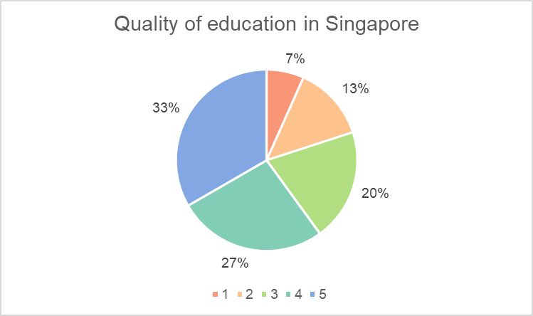
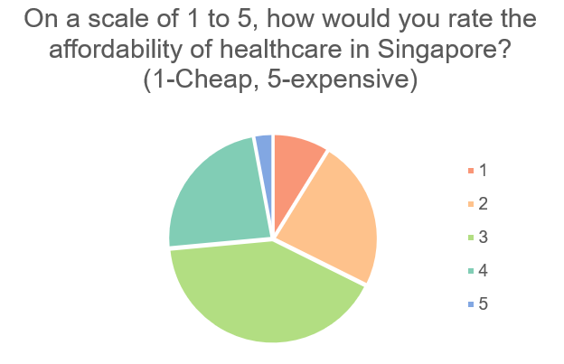
Survey Analysis
Education
healthcare
(Fig 1)
(Fig 2)
(Fig 1) 3/5 of the respondents rates the quality for education in Singapore much better (level 4-5) compared to other countries.
1/4 of the respondents rate that education in Singapore is much worse (level 1-2) than other countries. 1/4 of the respondents remained neutral.
(Fig 2) 1/3 of the respondents say the healthcare in Singapore is relatively affordable (level 1-2), while 1/3 remains neutral.
However, having 1/3 of respondents say that it is relatively expensive (level 4,5) shows that there’s a significant diversity of opinions about the cost of healthcare.
Click Here to View Our Survey Questions
VAP Project Survey Response data charts and responses

Slide 9
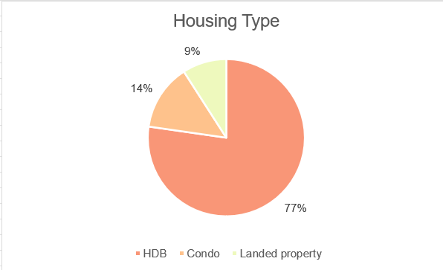
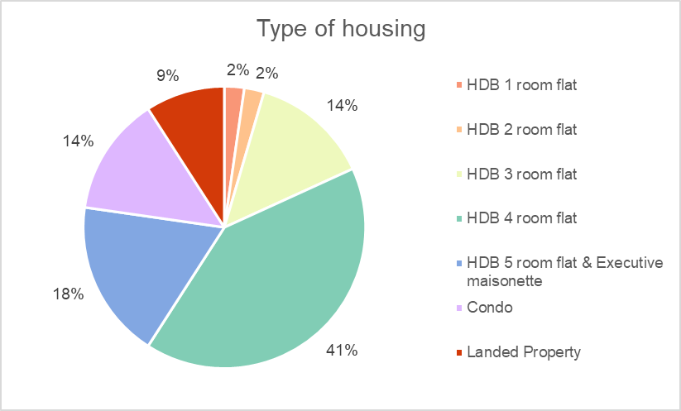
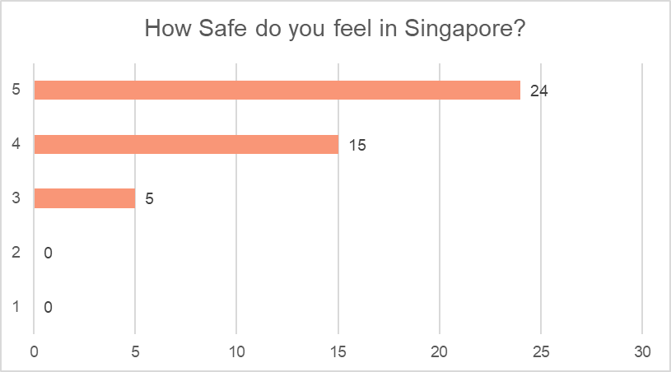
Survey Analysis
HOUSING
SAFETY
(Fig 4)
(Fig 5)
(Fig 6)
We asked, “What is your ideal house type”?
1 in 3 young adults choose HDB as their preference, and majority (41%) of them choose HDB 4 room flat as their ideal house type.
This question helps us to be able to know which area of housing to focus more on like HDB rental/selling prices and comparison of different types of HDB prices.
Almost all the respondents feel that they are secure in Singapore. About 88% of the respondents felt safe in Singapore (range 4-5) and remaining 12% felt neutral about their safety in Singapore.

Slide 10



Interview
8 Interviewees
Aged 16-25
Diverse Backgrounds
We Interviewed a total of 8 people.
Our interviewees are aged between 16-25.
Our interviewees comes from backgrounds such as:
Permanent Residence
Singaporeans
JC Students
Polytechnic Students

Slide 11
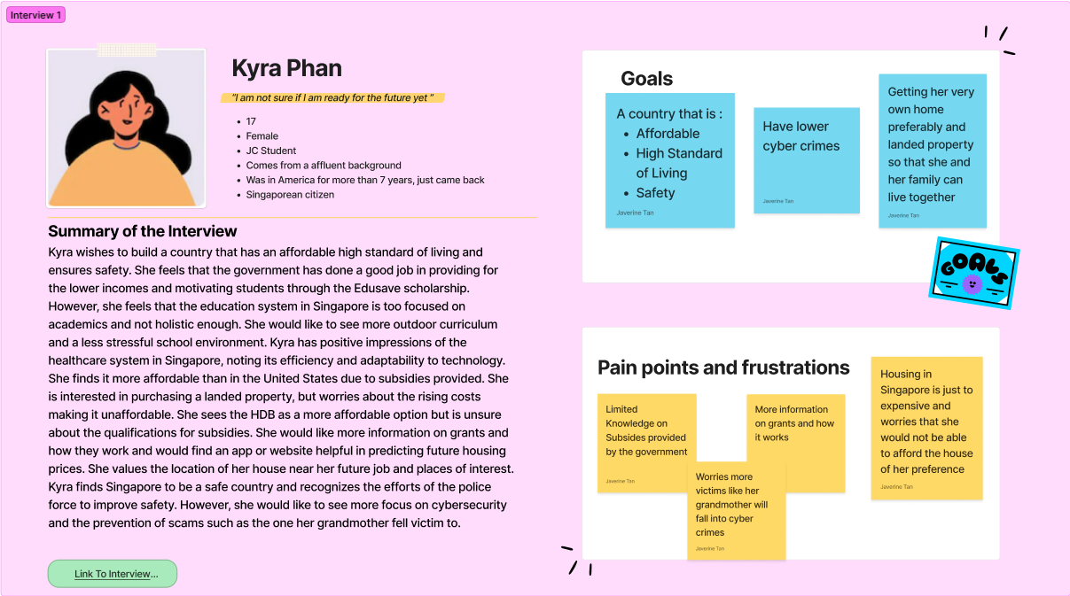
Persona – Kyra Phan

Slide 12
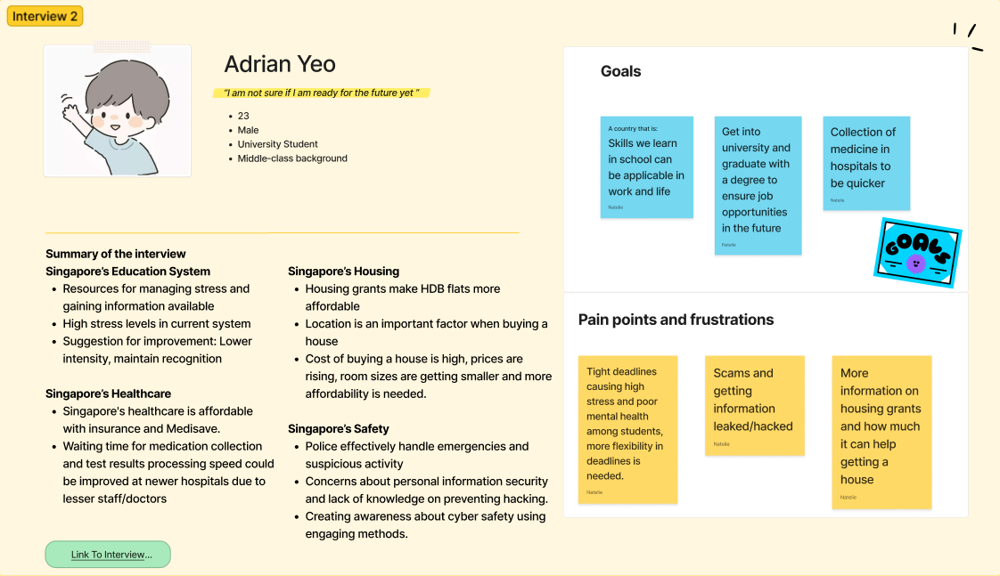
Persona – ADRIAN YEO

Slide 13
User Stories
As a young adult, I want to be able to know if the Singapore education is good, so that I can decide if I should continue to study in Singapore when I go to University.
As a young adult, I want to be able to know the timings of the waiting time, so that I can better plan my visit to the doctor when waiting time is shorter.
As a young adult, I want to be able to know more about the prices of housing and subsidies given, so that I can better prepared how much money I need in the future to get my own house
As a young adult, I want the government to educate and spread awareness about crimes and how to prevent them, so that I will not be a victim of crime.
Education
Healthcare
Housing
Safety
Interview 4
Interview 3
Interview 2
Interview 1

Slide 14
Problem statements
With our interviews and survey, we identified the following problem statements:
Singapore has the best Healthcare (Amber)
Singapore has the best Housing (Javerine)
Singapore has the best Education system (Natelie)
Singapore is the Safest country (Damian)

Slide 15
Our Approach
PHASE 1: Requirements Gathering | Jan 2023
Gathering of requirements via interviews and surveys.
PHASE 2: Prep & Modeling | Mid Jan 2023
Preparing of data for visualization.
PHASE 3: Data Visualization | MiD FeB 2023
Creation of analysis dashboard.
Click here to see our project scheduling

Slide 16
Datasets
EDUCATION
HOUSING
Housing Grants Awarded, by Type of Housing Grant-Data.gov.sg
https://data.gov.sg/dataset/resale-flat-prices
https://www.propertyguru.com.sg/property-guides/hdb-near-mrt-how-much-more-56969
HEALTHCARE
SAFETY
https://data.gov.sg/dataset/health-facilities
MOH | Beds Occupancy Rate (BOR)
https://tablebuilder.singstat.gov.sg/table/TS/M890541
REFERENCES
Pitch Mr Heng's Quote
Goh, Y.H.(2021) Understanding Economics, finance useful for youth, can help tackle real-world problems: DPM Heng, The Straits Times. Available at: https://www.straitstimes.com/singapore/understanding-economics-finance-valuable-for-young-people-can-help-address-real-world (Accessed: January 11, 2023).
Education quote
Teng, A. (2023) Focus on 5 key areas to keep education system relevant in uncertain world: Chan Chun Sing, The Straits Times. Available at: https://www.straitstimes.com/singapore/parenting-education/focus-on-5-key-areas-to-keep-education-system-relevant-in-uncertain-world-chan-chun-sing (Accessed: January 11, 2023).
Healthcare quote
Goh, Y.H. (2022) Job security, healthcare costs top two concerns in poll on forward Singapore Topics, The Straits Times. Available at: https://www.straitstimes.com/singapore/job-security-healthcare-costs-top-two-concerns-in-poll-on-forward-singapore-topics (Accessed: January 11, 2023).
Housing quote
Goh, Y.H. (2022) Singapore committed to affordable public housing, will intervene as needed: Desmond Lee, The Straits Times. Available at: https://www.straitstimes.com/singapore/politics/singapore-committed-to-affordable-public-housing-will-intervene-as-needed-desmond-lee (Accessed: January 11, 2023).
Safety quote
Bose, P. (2022) Singapore is the safest country in the world for International Travel, Lifestyle Asia India. Available at: https://www.lifestyleasia.com/ind/whats-on/news-whats-on/singapore-is-safest-country-in-the-world-for-international-travel/ (Accessed: January 11, 2023).

Slide 17
THANK YOU

